Slide 1
The eXpress Data Path: Fast Programmable Packet Processing in the Operating System Kernel 2018 ACM CoNEXT 254 citations
Rohullah Jahanafrooz
1401/11/09

Slide 2
Problem
Problem: High speed packet processing is hard
Goal: high speed programmable packet processing for user-space applications
Challenges:
Millions of packets per second
Operating system stacks are too slow

Slide 3
In brief
No complete kernel bypass
XDP is kernel space and runs along kernel network stack in a virtual environment (eBPF).
We write our codes in C and compile it to eBPF byte code and then to native code
Benefits:
Integrated with the kernel; driver retains control of hardware
Can selectively use kernel stack features
Stable API
No packet re-injection needed
Transparent to the host
Dynamically re-programmable
Doesn’t need a full CPU core

Slide 4
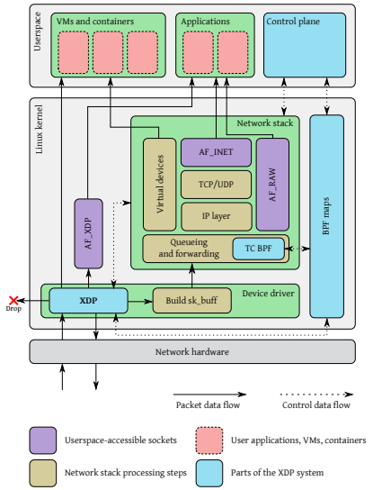
Architecture
Components:
XDP driver hook
eBPF virtual machine
BPF maps
eBPF verifier

Slide 5
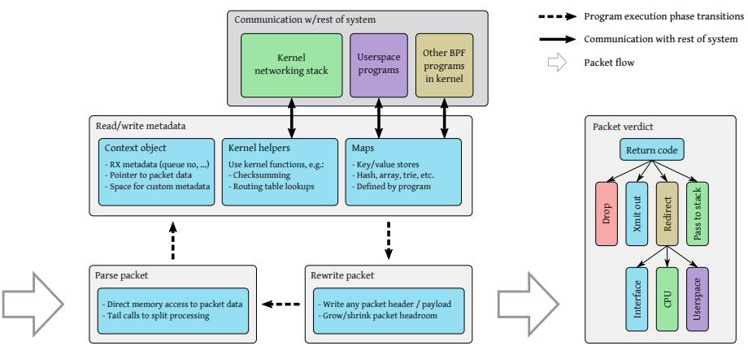
Workflow

Slide 6
Performance benchmark
Benchmark against DPDK and Linux network stack
metrics:
Packet drop performance
CPU usage
Packet forwarding performance
All tests are with 64 bytes packets (packets per second)

Slide 7
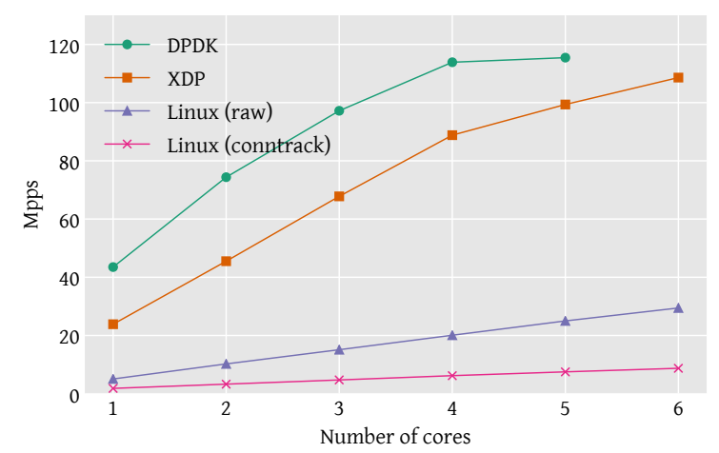
Packet Drop

Slide 8
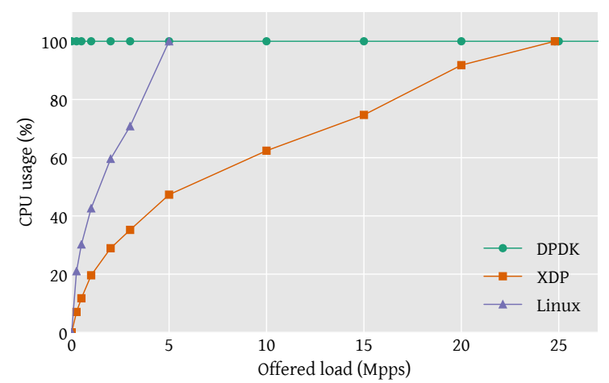
CPU usage in drop test

Slide 9
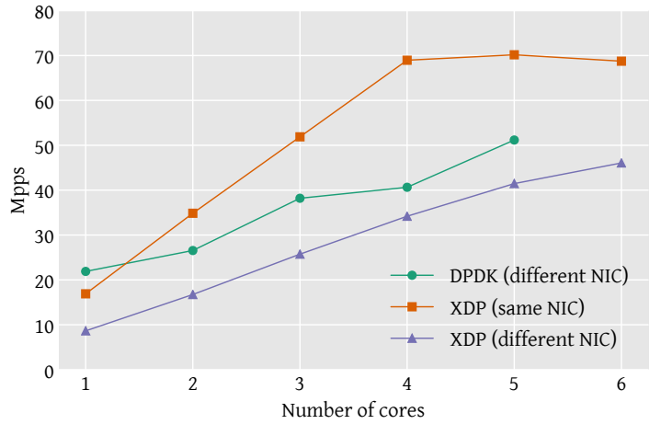
Packet forwarding throughput

Slide 10
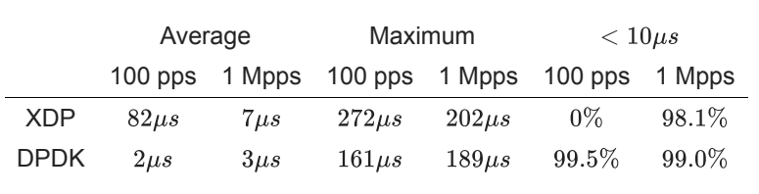
Packet forwarding latency

Slide 11
Real world scenarios
Feasibility of three real world application:
Layer 3 software routing
Inline DDoS protection
Layer-4 load balancer
It is not a benchmark against other high-speed packet processing methods

Slide 12
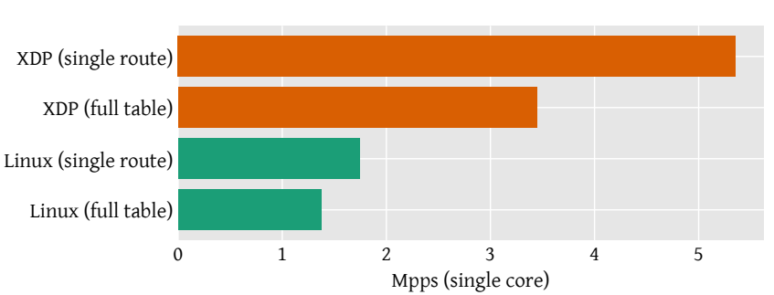
Layer 3 routing

Slide 13
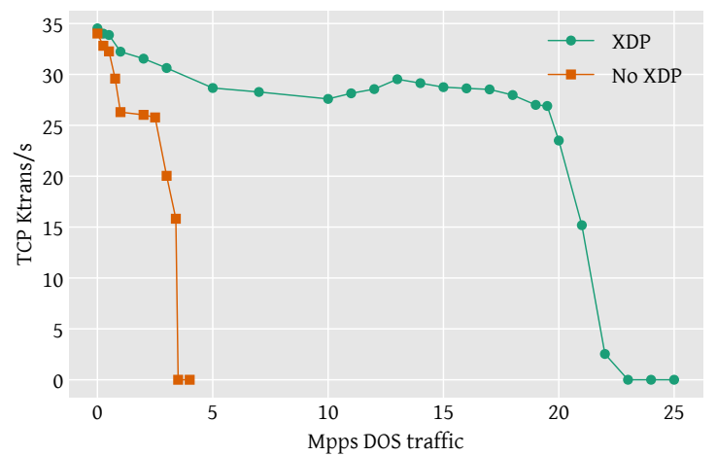
Inline DDoS protection

Slide 14
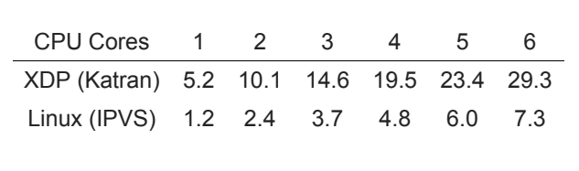
Layer4 load balancer

Slide 15
Relation
Which component of our architecture? For devices that we receive and capture traffic on their interfaces
Which problem it solve? High speed packet processing
Why to use it? Integrates easily and no corruption.

